Slide 1
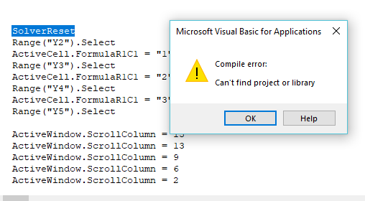
How to fix… Cannot find Solver

Slide 2
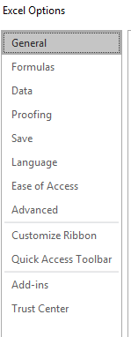
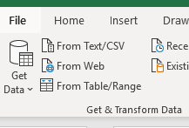
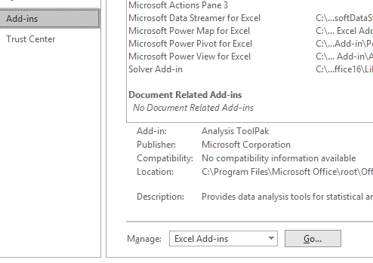
1 = Click on File in Top Menu
3 = Click on Add-Ins
2= Click on Options
4 = Click on Go

Slide 3
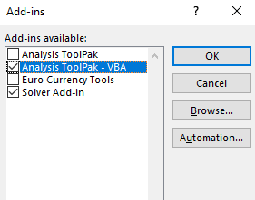
5 = Select both Analysis ToolPak-VBA and Solver Add-in

Slide 4
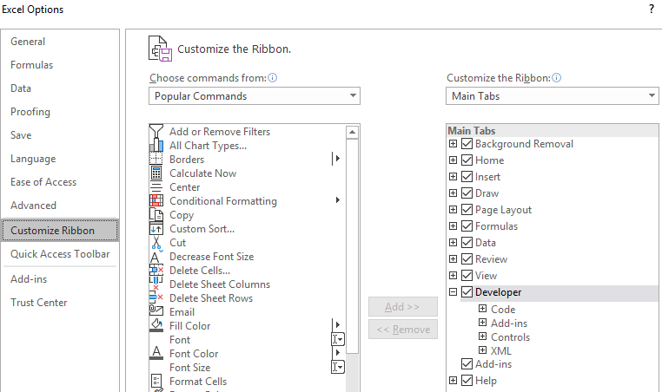
6 = Under File ➔ Excel Options (again), go to Customize Ribbon and add ‘Developer’ (which will add it to your top level menu)

Slide 5
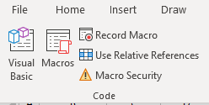
7 = Select ‘Developer’ in the Main Menu
If not there automatically ➔ save file and reopen
8 = Select Visual Basic
9 = Select Tools

Slide 6
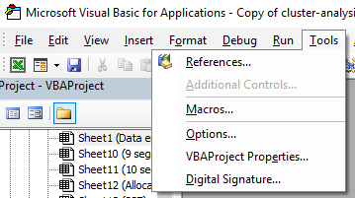
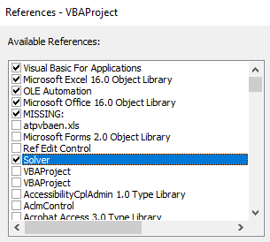
10 = Select References
11 = Select Solver
12 = Unclick MISSING if it is ticked
Final Step
Save File
Macros will now run

